Slide 1
INTERNSHIP PROGRESS REPORT
IN IMAGE PROCESSING
Name: Sneha Dadhich
Year: 3rd year (7th Semester)
College: Jodhpur Institute of Engineering and Technology
Internship Organization : DRDO ( Defence Research and Development Organisation (DRDO) )
Organization Mentor: Rajendra Kumar Khatri

Slide 2
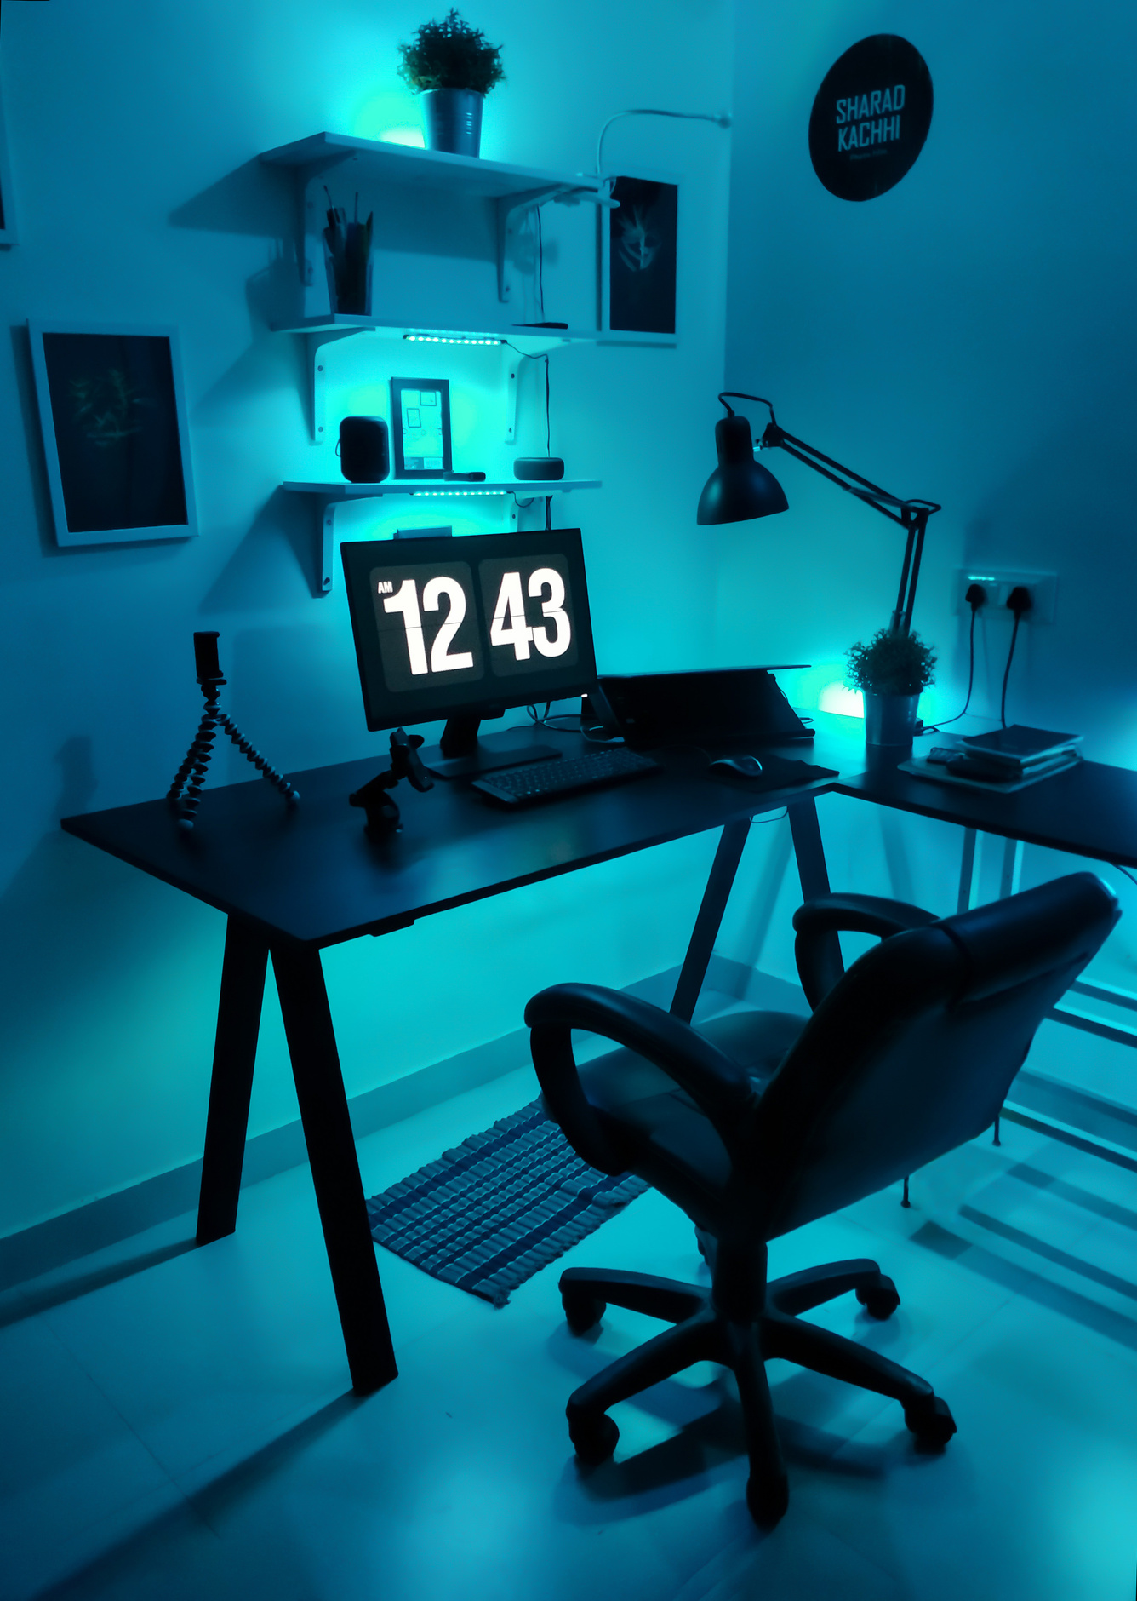
Index :
Splitting & Merging Color Channels
Image Addition & Subtraction
Bitwise Operations on Images
Image Masking
Scaling & Translation
Perspective Transformation
Edge Detection (Canny Algorithm)

Slide 3
Splitting & Merging Color Channels
Splitting: Digital images in OpenCV are typically in BGR (Blue, Green, Red) format.
Using cv2.split(image), we extract each channel separately.
This helps analyze the individual contribution of each color channel.
Merging: After processing channels individually, cv2.merge((b, g, r)) can recombine them.
Important in color enhancement, thresholding per channel, and histogram analysis.
Applications:
Skin tone detection, vegetation analysis, color filtering.

Slide 4
Code :
import cv2
image = cv2.imread(r"C:\Users\Dell\Desktop\Sneha2.0\Programs1\Python\DRDO\images\bg2.jpg")
# splitting the colour channel
blue_channel, green_channel, red_channel = cv2.split(image)
# cv2.imshow('Blue Channel', blue_channel)
# cv2.imshow('Green Channel', green_channel)
# cv2.imshow('Red Channel', red_channel)
# cv2.waitKey(0)
# cv2.destroyAllWindows()
merged_image = cv2.merge([red_channel ,green_channel, blue_channel ]) # RGB channel
merged_image2 = cv2.merge([blue_channel ,green_channel, red_channel ]) # RGM channel
cv2.imshow("Merged_image", merged_image)
cv2.imshow("Merged_image 2 ", merged_image2)
cv2.waitKey(0)
cv2.destroyAllWindows()

Slide 5
Combining and Subtracting Two Images
Combines pixel intensities: cv2.add(img1, img2)
Automatically handles overflow (caps at 255), unlike NumPy addition.
Useful for image blending and superimposing.
Both images must be of the same size and data type.
01
Image Addition:
Exposure Correction: Adding a constant image (bright mask) to brighten dark regions.
Object Overlay: Add foreground objects (like transparent masks or AR effects) over a background.
Image Stitching (Low-Level): In panorama creation, overlaps are sometimes averaged using addition.
Noise Simulation: Add random noise to an image by adding a noise array:
Applications and Use Cases

Slide 6
Combining and Subtracting Two Images
Highlights differences: cv2.subtract(img1, img2)
Negative results are clipped to zero.
Often used in motion detection or identifying changes between frames.
Both images must be of the same size and data type.
02
Image Subtraction:
Change Detection: Detect differences between two images (e.g., surveillance, defect inspection).
Object Isolation: Remove unwanted overlays or extract changes by subtracting known templates.
Image Comparison: Used in quality control and visual comparison tasks (e.g., in manufacturing).
Edge-like Highlighting: Subtracting a blurred version from the original can highlight details (similar to high-pass filtering).
Applications and Use Cases

Slide 7
Code of Combining Images (Both Non-Weighted and Weighted):
import cv2
import numpy as np
image = cv2.imread(r"DRDO\images\wallpaper.jpg")
image2 = cv2.imread(r"DRDO\images\bg1.jpg")
# changing the dimensions of the image
image = cv2.resize(image,(600,600))
image2 = cv2.resize(image2,(600,600))
# take images of same dimensions (hame width, height and channel) to combine them
added_image = cv2.add(image2, image)
print(added_image.shape)
cv2.imshow("Combined Image",added_image)
cv2.waitKey(0)
cv2.destroyAllWindows()

Slide 8
Code of Combining Images (Both Non-Weighted and Weighted):
# adding the image via weight
added_image2 = cv2.addWeighted(image, 0.25, image2, 1.0, 10)
cv2.imshow("Combined Image Via Weight",added_image2)
cv2.waitKey(0)
cv2.destroyAllWindows()

Slide 9
Subtracting the Combining Images
import cv2
import numpy as np
image = cv2.imread(r"DRDO\images\wallpaper.jpg")
image2 = cv2.imread(r"DRDO\images\bg1.jpg")
# changing the dimensions of the image
image = cv2.resize(image,(600,600))
image2 = cv2.resize(image2,(600,600))
# order of the image is important as it is not commutative
subtracted_image = cv2.subtract(image, image2)
cv2.imshow("Subtracted Image", subtracted_image)
cv2.waitKey(0)
cv2.destroyAllWindows()

Slide 10

Bitwise Operations on Images
What They Do:
Operate at the binary level (0s and 1s of pixel values).
Typically used with binary masks (0 = black, 255 = white).

Slide 11
Bitwise Operations on Images
bitwise_and: Common pixels (intersection)
Returns white (255) only if both pixels are white at the same position in images else returns black .
Use Case:
Extracting overlapping regions (e.g., applying a mask to an image).
Example: Keep only the circular area of an object using a circular mask

Slide 12
Bitwise Operations on Images
bitwise_or: All active pixels (union)
Returns white (255) if specific pixels in either image is white.
Only returns black (0) if both pixels are black.
Use Case:
Merging two regions of interest (ROIs).
Useful in image combination, overlays, or shape unions.

Slide 13
Bitwise Operations on Images
bitwise_xor: Exclusive pixels
Returns white (255) if only one of the pixels in both images is white.
Returns black (0) if both are black or both are white.
Use Case:
Highlight non-overlapping regions.
Used in creating outlines or comparing masks.

Slide 14
Bitwise Operations on Images
bitwise_not: Inverts pixel bits (255 → 0, 0 → 255)
Inverts the image i.e. :
White (255) becomes Black (0)
Black (0) becomes White (255)
Use Case:
Inverting masks
Preparing inverse ROI for masking
Artistic effects or data augmentation

Slide 15
Code to Implement Bitwise Operation (Sample Code ) :
import cv2
import numpy as np
image = cv2.imread(r"DRDO\images\bitwise.jpg")
image2 = cv2.imread(r"DRDO\images\bitwise2.jpg")
# changing the dimensions of the image
image = cv2.resize(image,(600,600))
image2 = cv2.resize(image2,(600,600))
#bitwise 'and' operation
bit_add_img = cv2.bitwise_and(image, image2)
cv2.imshow("Bitwise Added Image", bit_add_img)

Slide 16
Code to Implement Bitwise Operation (Sample Code ) :
#bitwise 'or' operation
bit_add_img2 = cv2.bitwise_or(image, image2)
cv2.imshow("Bitwise 'Or' Image", bit_add_img2)
#bitwise 'xor' operation ie convert black to white and white to black
bit_add_img3 = cv2.bitwise_xor(image, image2)
cv2.imshow("Bitwise 'Or' Image", bit_add_img3)
cv2.waitKey(0)
cv2.destroyAllWindows()

Slide 17
Image Masking
Concept :
Image masking is a technique used in photo editing to separate or isolate specific areas of an image from the rest, allowing for more precise editing and manipulation.
Essentially, it's like placing a “mask” over the parts of a picture you want to protect or hide while exposing the other areas for editing.
Concept :
A binary image used to select which parts of another image to process.
Mask = same size as input, contains 0s and 255s only.

Slide 18
Image Masking
How it works:
bitwise_and(src, src, mask=mask) keeps pixels where mask = 255, discards others.
Uses:
Background subtraction
Isolating objects in a scene
Focused image analysis (e.g., analyzing only the face region)

Slide 19
Masking the Image
import cv2
img_for_mask = cv2.imread(r"DRDO\images\mask1.png")
img1 = cv2.imread(r"DRDO\images\wallpaper.jpg")
img2 = cv2.imread(r"DRDO\images\bg1.jpg")
# converting the image used for greyscale to greyscale
circle_grayscale = cv2.cvtColor(img_for_mask, cv2.COLOR_BGR2GRAY)
# resizing the image to be added
img1 = cv2.resize(img1, (500, 500))
img2 = cv2.resize(img2, (500, 500))
circle_grayscale = cv2.resize(circle_grayscale, (500, 500))
# creating a mask
retval , mask = cv2.threshold(circle_grayscale, 10, 255, cv2.THRESH_BINARY)

Slide 20
Masking the Image
# inverting the mask
retval2 , mask2 = cv2.threshold(circle_grayscale, 10, 255, cv2.THRESH_BINARY_INV)
# making an inverted mask
inv_mask = cv2.bitwise_not(mask)
# Adding the img1 and img2
added_image = cv2.add(img1, img2, mask = mask)
added_image2 = cv2.add(img1, img2, mask = mask2)
cv2.imshow("Combined Image with Mask", added_image)
cv2.imshow("Combined Image with Inverted Mask", added_image2)
cv2.waitKey(0)
cv2.destroyAllWindows()

Slide 21
Exploring the different interpolation methods in Scaling of Images
Interpolation :
When we resize an image (make it larger or smaller), we need to estimate the new pixel values because the original pixel grid no longer fits the new size exactly.
This "guessing" of new pixel values is called interpolation.

Slide 22
1. Nearest Neighbor Interpolation (INTER_NEAREST)
Picks the closest pixel from the original image without any averaging (no calculation , just copying ) i.e. making the pixels bigger without smoothening the edges
Use Case:
When speed is more important than quality.
When working with segmentation masks or pixel art (to preserve sharp edges).
Pros:
Very fast
Preserves hard edges
Cons:
Output can be blocky and jagged
🔸

Slide 23
2. Bilinear Interpolation (INTER_LINEAR)
How it works:
Uses the 4 nearest pixels and calculates a weighted average based on distance.
It "blends" between neighboring pixels to smooth the result.
Use Case:
Default for enlarging photos in OpenCV
General-purpose image scaling
Pros:
Good quality and fast
Less blocky than nearest
Cons:
Slight blurring in sharp images

Slide 24
3. Area-Based Interpolation (INTER_AREA)
How it works:
Calculates the average of multiple pixels in the input image that map to one pixel in the output - Like compressing a group of colored blocks into one — you average the color of the group.
Especially useful when shrinking images.
Use Case:
Best for downsizing images (reducing resolution)
Used in creating thumbnails or compressed previews

Slide 25
3. Area-Based Interpolation (INTER_AREA)
Pros:
Excellent quality when shrinking
Preserves overall color and structure well
Cons:
Not suitable for enlarging (results in blurring)

Slide 26
4. Bicubic Interpolation (INTER_CUBIC)
How it works:
Uses 16 neighboring pixels (4x4 grid) and applies a cubic polynomial for smooth results.
More advanced than bilinear; smoother curves and edges.
Use Case:
High-quality upscaling (better than bilinear)
When visual appearance matters (e.g., photo enlargement)

Slide 27
5. Lanczos Interpolation (INTER_LANCZOS4)
How it works:
Uses a mathematical sinc function and 8x8 neighboring pixels.
Designed for high-quality resizing.
Use Case:
Best for enlarging high-resolution images where you want to retain maximum detail
Scientific or print-quality processing
Pros:
Highest quality among standard methods
Preserves edges and fine detail
Cons:
Computationally expensive (slower)

Slide 28

import cv2
# reading the image
img1 = cv2.imread(r"DRDO\images\leaf.jpg")
# displaying the original image
cv2.imshow("Original Image", img1)
cv2.waitKey(0)
cv2.destroyAllWindows()
# propertion of downscaling
downscale_pt = 40
# downscaling points
height_down = int(img1.shape[0] * downscale_pt / 100)
wdth_down = int(img1.shape[1] * downscale_pt / 100)
dimension_down = (wdth_down, height_down)
Scaling of the Image ( Upscaling and Downscaling)
Code :

Slide 29
Scaling of the Image ( Upscaling and Downscaling)
Code :
image_resize_down = cv2.resize(img1, dimension_down)
cv2.imshow("Downscaled Images", image_resize_down)
cv2.waitKey(0)
cv2.destroyAllWindows()
# downscaling the image by recommended method for downscaling - cv2.INTER_AREA
image_resize_down2 = cv2.resize(img1, dimension_down, interpolation = cv2.INTER_AREA)
cv2.imshow("Downscaled Images By Recommended Method ( cv2.INTER_AREA )", image_resize_down2)
cv2.waitKey(0)
cv2.destroyAllWindows()
# propertion of upscaling
upscale_pt = 300

Slide 30
# upscaling points
height_down2 = int(img1.shape[0] * upscale_pt / 100)
wdth_down2 = int(img1.shape[1] * upscale_pt / 100)
dimension_up = (wdth_down2, height_down2)
image_resize_up = cv2.resize(img1, dimension_up)
cv2.imshow("Upscaled Images", image_resize_up)
cv2.waitKey(0)
cv2.destroyAllWindows()
# downscaling the image by recommended method for upscaling - cv2.INTER_CUBIC
image_resize_up2 = cv2.resize(img1, dimension_up, interpolation = cv2.INTER_CUBIC)
cv2.imshow("Upscaled Images By Recommended Method ( cv2.INTER_CUBIC )", image_resize_up2)
cv2.waitKey(0)
cv2.destroyAllWindows()
Scaling of the Image ( Upscaling and Downscaling)
Code :

Slide 31
Comparision Table of Interpolation Method
Comparision Table of Interpolation Method
Name in
OpenCV
Use Case
Fastest, simple zoom or thumbnails
Nearest Neighbor
cv2.INTER_NEAREST
Bilinear
cv2.INTER_LINEAR
Default for upscaling
Area-Based
cv2.INTER_AREA
Best for shrinking
Bicubic
cv2.INTER_CUBIC
High-quality upscaling
Lanczos
cv2.INTER_LANCZOS4
Highest quality scaling

Slide 32
Image Translation
Image Translation is a geometric transformation that shifts an image from one location to another along the X and/or Y axis — without altering its shape, size, or orientation.
Image translation is done using a 2x3 affine transformationmatrix:
T = [ 1 0 tx ]
[ 0 1 ty ]
Where:
tx​: shift along the x-axis
ty​: shift along the y-axis
Command : cv2.warpAffine() applies the matrix to the image.

Slide 33
Code :
import cv2
import numpy as np
# reading the image
img1 = cv2.imread(r"DRDO\images\leaf.jpg")
height, width = img1.shape[:2]
transformation_matrix = np.float32([ [1, 0, 100], [0, 1, 40] ]) # there will be 0 on img1[0:100] and img1[1:40]
transformation_matrix2 = np.float32([ [1, 0, -100], [0, 1, -40] ])
transformation_image = cv2.warpAffine( img1, transformation_matrix, (width, height))
transformation_image2 = cv2.warpAffine( img1, transformation_matrix2, (width, height))

Slide 34
Code :
transformation_image2 = cv2.warpAffine( img1, transformation_matrix2, (width, height))
print(f"Original Image Resolution (Width, Height) : {img1.shape}")
print(f"Transformed Image Resolution (Width, Height) : {transformation_image.shape}")
cv2.imshow("Transformed Image (Top Left)", transformation_image)
cv2.waitKey(0)
cv2.destroyAllWindows()
cv2.imshow("Transformed Image (Bottom Right)", transformation_image2)
cv2.waitKey(0)
cv2.destroyAllWindows()

Slide 35
Perspective Transformation
What is it ?
A geometric operation that alters the viewpoint of an image.
Changes the image from an angled view to a top-down or front-facing one.
How it works :
Identify 4 source points on the input image.
Specify 4 destination points for the output.
Get the transformation matrix: cv2.getPerspectiveTransform(src_pts, dst_pts)
Apply it: cv2.warpPerspective(img, matrix, (w, h))

Slide 36
Perspective Transformation
Applications:
Document scanning
Lane detection in autonomous driving
3D effect simulation

Slide 37
Code :
import cv2
import numpy as np
# read the image
img1 = cv2.imread(r"DRDO\images\leaf.jpg")
# check if image is read properly
if img1 is None:
print("Image not found. Please check the path.")
exit()
# define 4 points in the original image (source points)
src_points = np.float32([[50, 50], [200, 50], [50, 200], [200, 200]])

Slide 38
Code :
# define 4 points where the source points should map to (destination points)
dst_points = np.float32([[0, 0], [300, 0], [0, 300], [300, 300]])
# compute the perspective transform matrix
matrix = cv2.getPerspectiveTransform(src_points, dst_points)
# apply perspective transformation
result = cv2.warpPerspective(img1, matrix, (300, 300))
# display result
cv2.imshow("Perspective Transformed", result)
cv2.waitKey(0)
cv2.destroyAllWindows()

Slide 39
Edge Detection with Canny Algorithm
Canny Edge Detection:
Developed by John F. Canny in 1986; a multi-stage edge detection algorithm designed to detect a wide range of edges robustly.
Stages:
Noise Reduction: Gaussian blur filters out noise.
Gradient Calculation: Sobel operator finds intensity gradients.
Non-Maximum Suppression: Thins out edges to 1-pixel width.
Double Thresholding: Classifies pixels into strong, weak, and non-edges.

Slide 40
Edge Detection with Canny Algorithm
5 Edge Tracking by Hysteresis: Connects weak
edges to strong ones if adjacent.
Syntax: cv2.Canny(image, threshold1, threshold2)

Slide 41
Code :
import cv2
import numpy as np
def edge_Detection( captured_frame ):
while 1 :
# read the frame from the camera
ret, frame = captured_frame.read()
# hue - ( 0 - 179 ) in opencv
# saturation - ( 0 - 255 ) : how much the value is mixed with white colour
# value - ( 0 - 255 ) : how much the value is mixed with black colour
hsv = cv2.cvtColor(frame, cv2.COLOR_BGR2HSV) # converting the BGR to HSV

Slide 42
Code :
gray_scale = cv2.cvtColor(frame, cv2.COLOR_BGR2GRAY) # converting the BGR to Grey
# displaying the gray frames converted in gray_scale
cv2.imshow("Grey", gray_scale)
# define the range of the HSV
lower_blue = np.array([110, 50, 50])
upper_blue = np.array([255, 255, 180])
mask = cv2.inRange(hsv, lower_blue, upper_blue)
# applying the bitwise operator - AND
# pixels that form in this range will be represeted by 1 while the rest will be represented by 0
result = cv2.bitwise_and(frame, frame, mask=mask)

Slide 43
Code :
# showing the binary image
cv2.imshow("bitwise frame", result)
# showing the original image too for comaprison
cv2.imshow("Original Image", frame)
# finding the strong edges by cranny algorithm
strong_edges = cv2.Canny(frame, 100, 200)
# display the cranny algorithm output
cv2.imshow("Detected Strong Edges", strong_edges)
# esc key termination window
k = cv2.waitKey(1) & 0xff

Slide 44
Code :
if k == 27:
break
# close the window()
captured_frame.release()
cv2.waitKey(1)
cv2.destroyAllWindows()
def initiate_web_cam():
capture_frame = cv2.VideoCapture(0)
# passing the captured input by webcam to edge_detection function
edge_Detection( capture_frame )
cv2.waitKey(1)
cv2.destroyAllWindows()
if __name__ == '__main__' :
initiate_web_cam()

Slide 45
Mini Project 1: Face Recognition Model
Tools Used : OpenCV, numpy, os, time
This project is a real-time face recognition system developed using OpenCV, the LBPH (Local Binary Patterns Histograms) algorithm, and Haar Cascade classifiers. The system is designed to automate two use cases: Attendance Monitoring and Exam Proctoring.
It comprises three main modules:
User Registration & Dataset Creation
Model Training using LBPH
Real-Time Face Recognition

Slide 46
Mini Project 1: Face Recognition Model
During registration, the system captures 30 grayscale facial images per user via webcam, labels them with a unique ID and name, and stores them in a structured dataset. These images are then used to train an LBPH-based face recognition model, which learns to identify users based on extracted facial features.
Once trained, the model can recognize faces in real-time from webcam input. When a face is detected, the system predicts the user's identity and displays it on-screen, along with the recognition confidence. For unrecognized users, a "NOT REGISTERED" label is shown.
This system supports:
Time-sensitive attendance marking (in progress)
Basic facial verification for proctored exams (in progress)
User-friendly interaction through GUI (Tkinter) (optional extension)

Slide 47
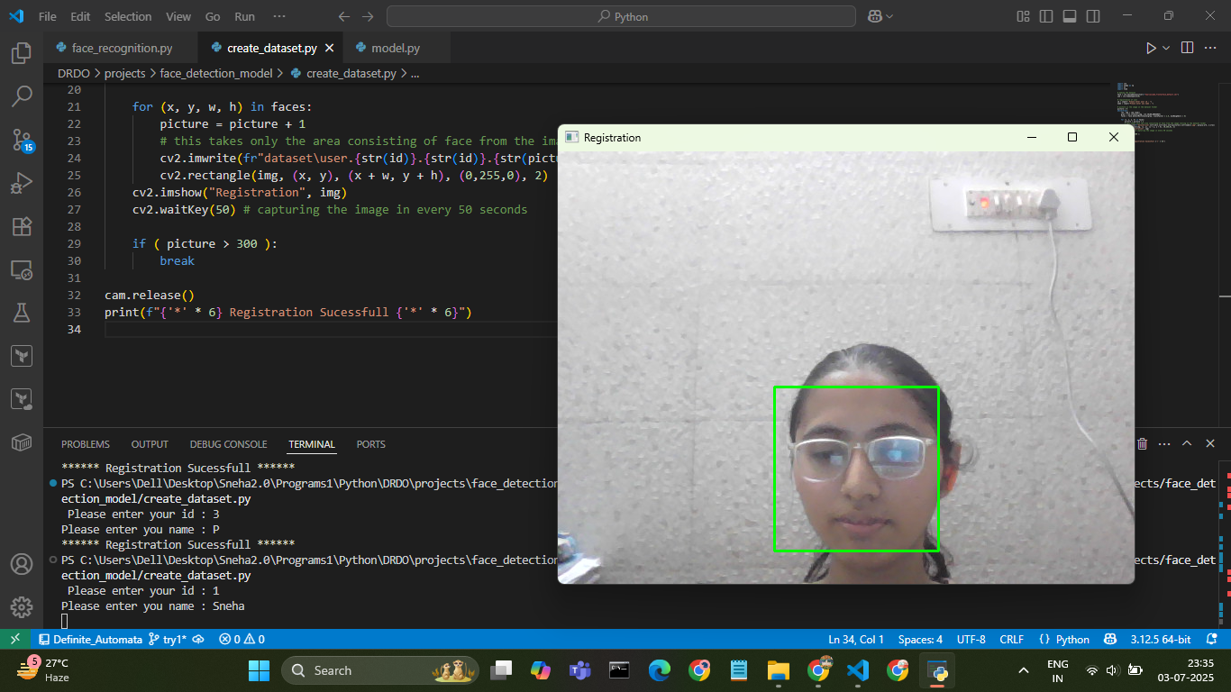
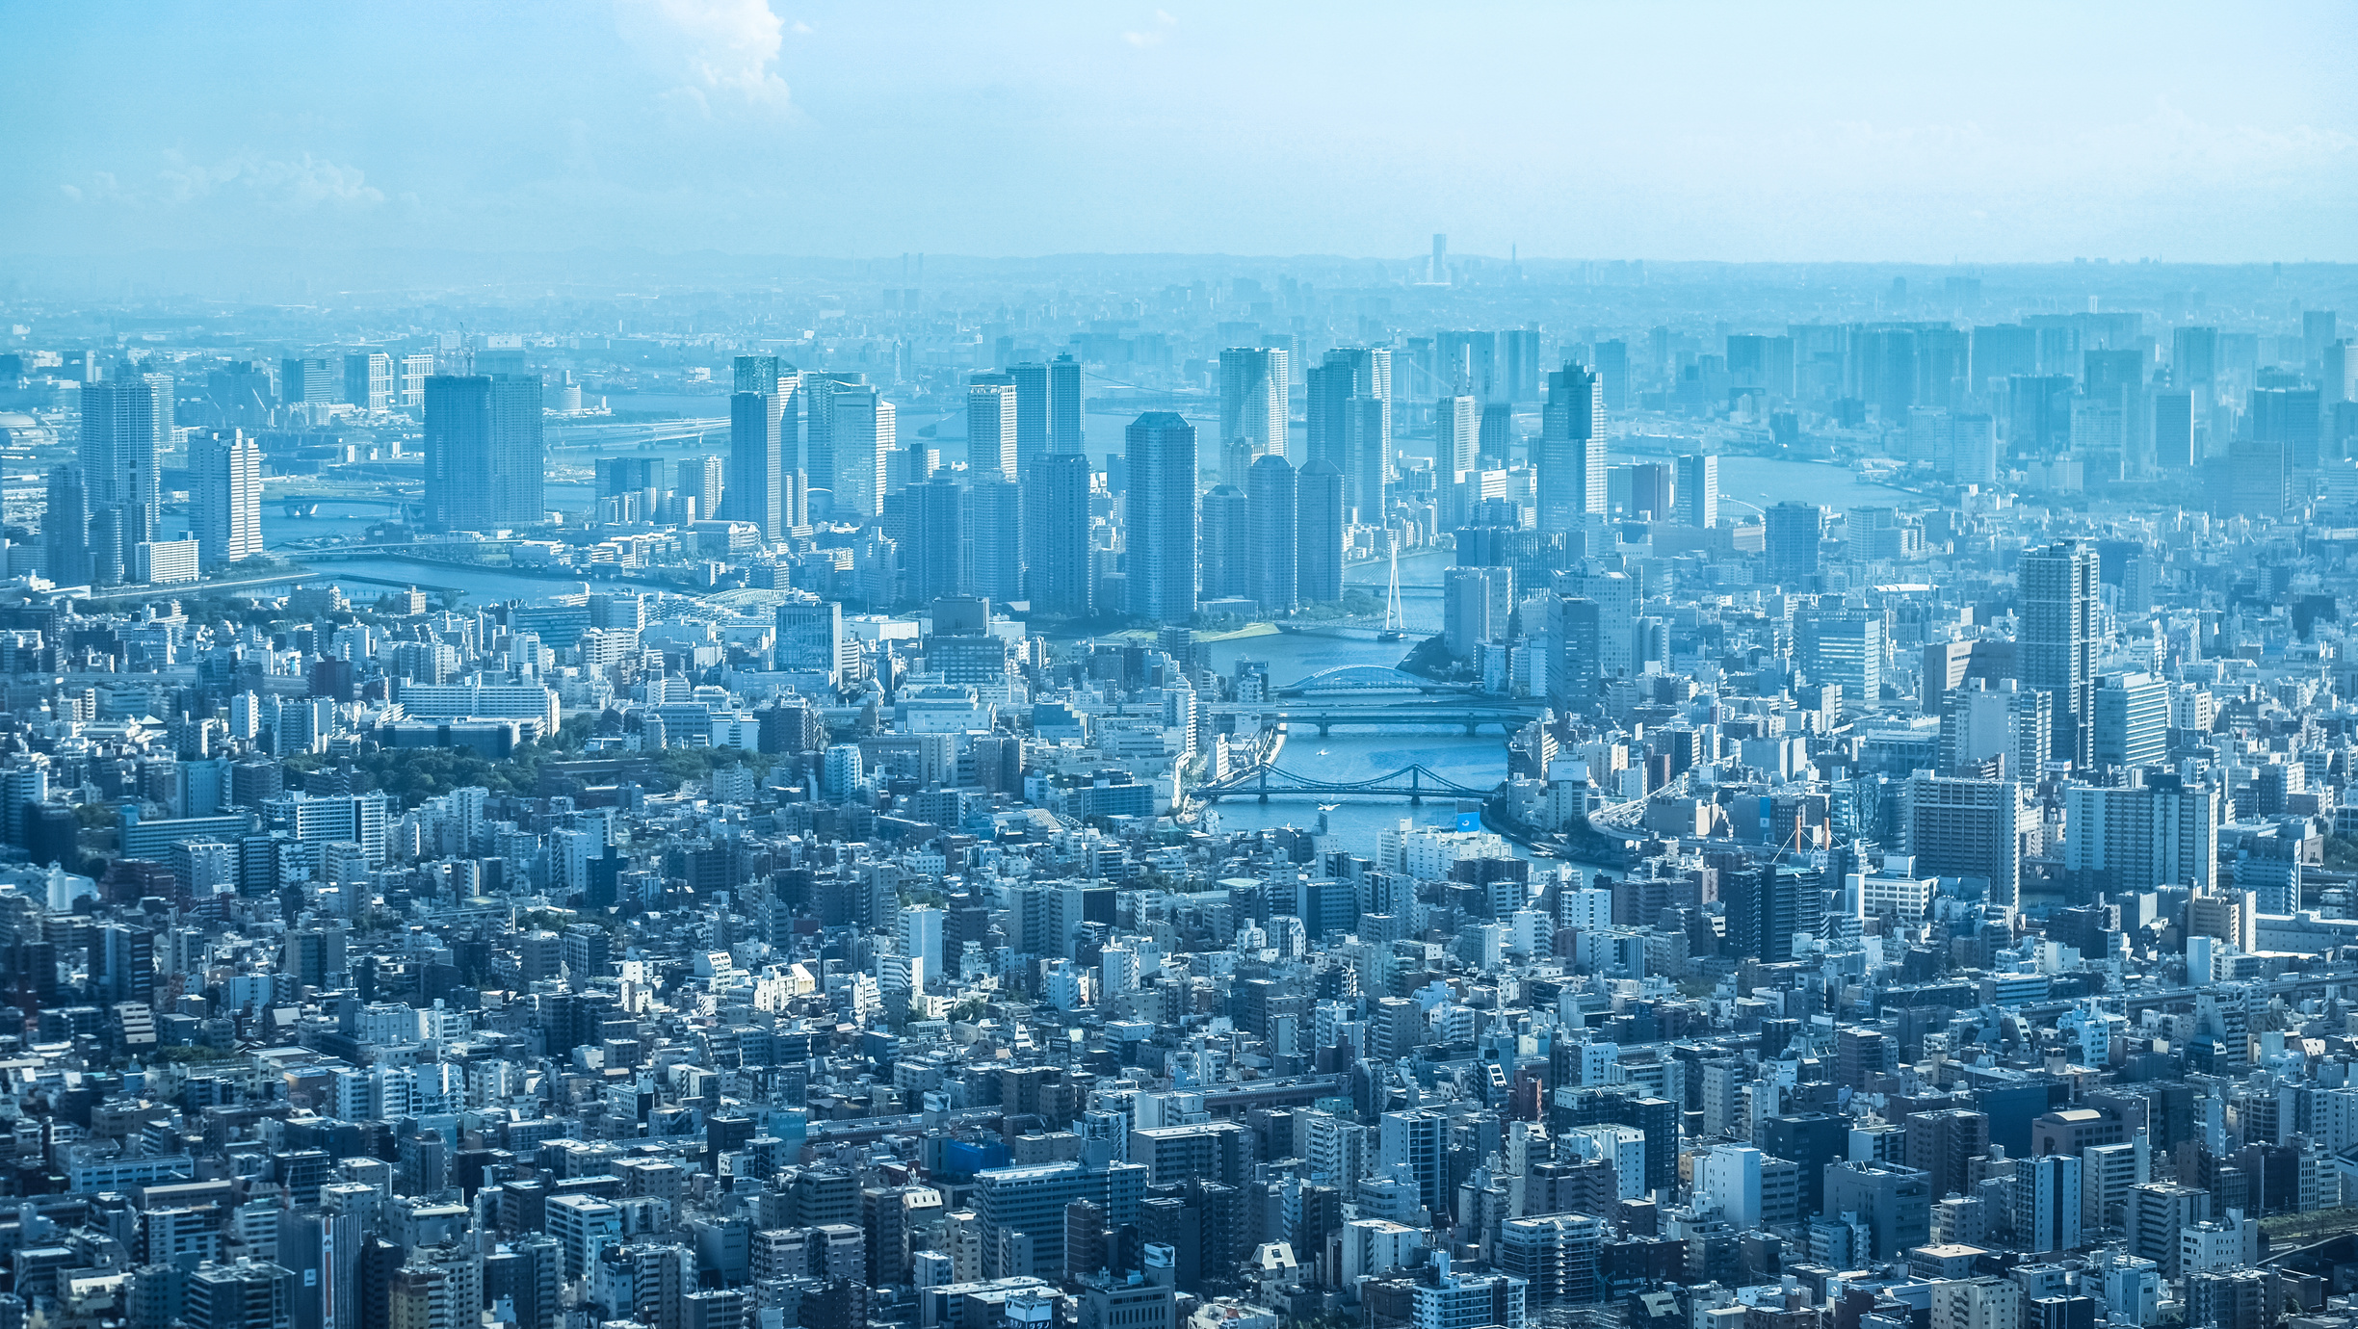
Person Registration

Slide 48
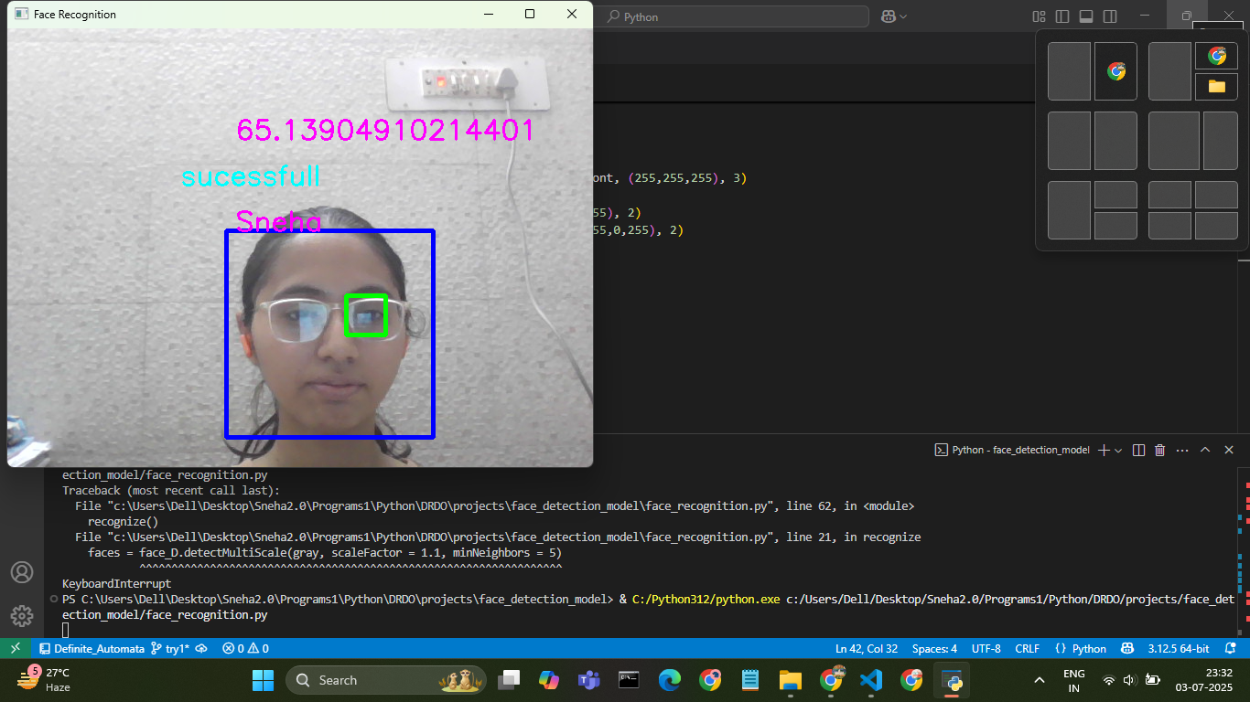
Person Recognition

Slide 49
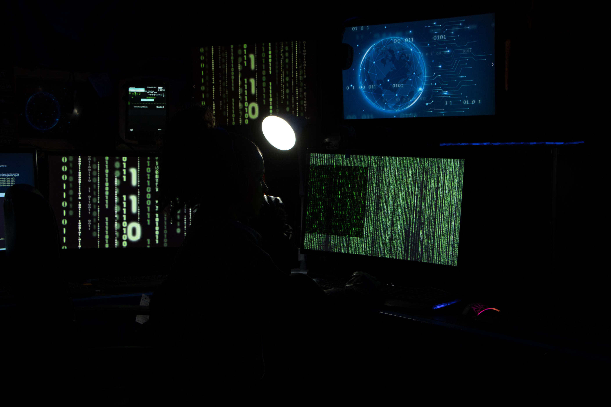
Future Projects ( Currently Under Progress)
Project 1: Face Recognition-Based Exam Proctoring System
This project implements a real-time face recognition system to verify the identity of students during online or offline examinations. Upon successful authentication, it fetches and displays the student’s details—such as name, seat number, room number, phone number, and email—from a preloaded CSV file. The system ensures that only authorized students can access the examination, enhancing exam integrity and reducing impersonation.

Slide 50
Future Projects ( Currently Under Progress)
Project 2: Face Recognition Attendance System with Time-Sensitive Status
This system captures student attendance through face recognition within a specified time window. Attendance taken during the valid period is marked as Present, while late entries are labeled as Late, each with a timestamp. After the final cutoff time, all remaining students are automatically marked as Absent in an Excel sheet. The solution streamlines the attendance process and enforces punctuality effectively.

